Slide 1
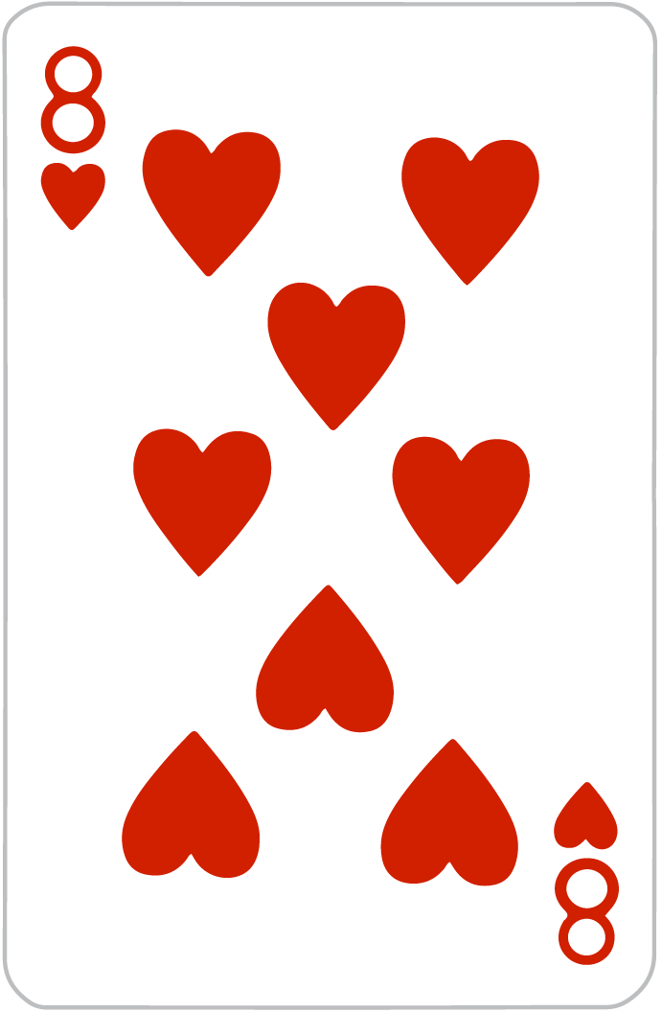
Crazy Eights
By Victoria, Will, and Jack

Slide 2

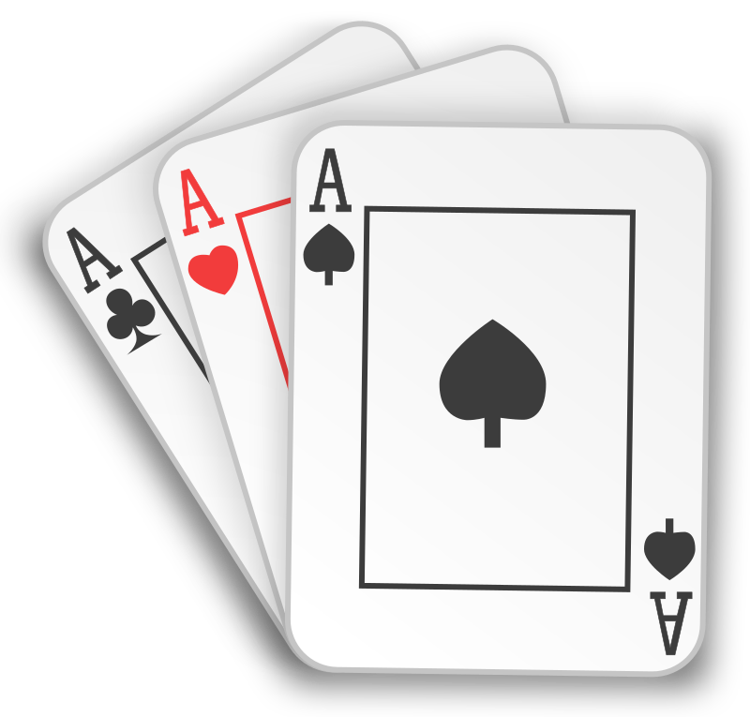
Introduction
Our Solution
—------------------
Multiplayer Functionality
Password Protected Lobbies
Full Crazy 8’s Functionality
User Signup / Sign In
Betting
Administrator Account
Advertising
Friends
Player Messaging
Client Eric Ebert
—---------------------
Requested: A functional multiplayer Crazy 8’s Game

Slide 3
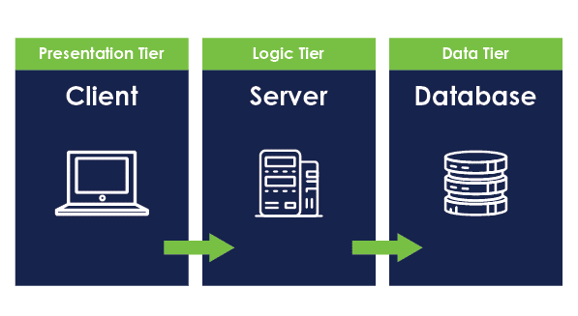



Architecture and Design

Slide 4
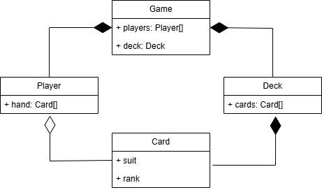
Architecture and Design cont.
Classes were all in the backend
Classes: Game, Player, Deck, Card

Slide 5
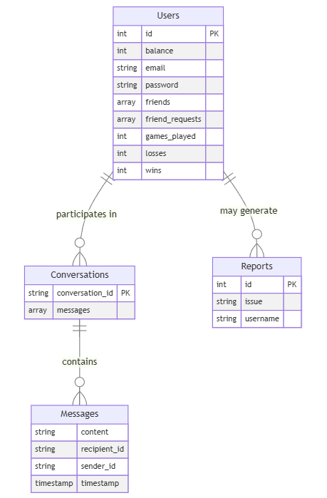
Persistence
NOSQL
Firebase
4 Collections
Users
Reports
Conversations
Messages

Slide 6
Requirements and User Stories
Meeting with the client
User stories
Kanban board
Points and slices
Notes:
Less text

Slide 7
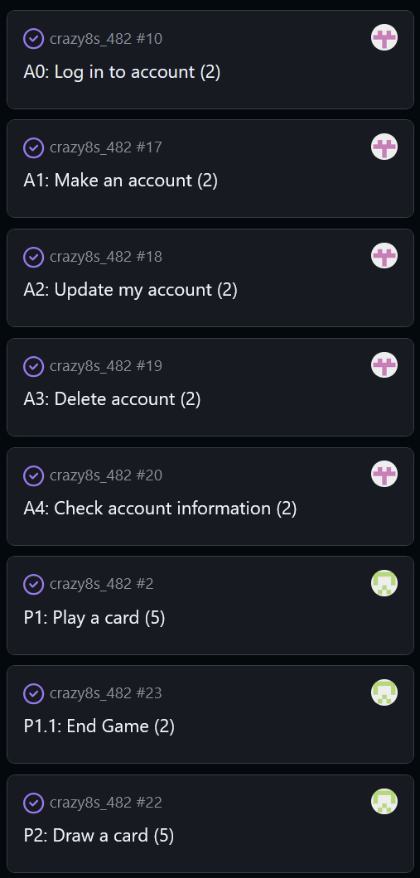
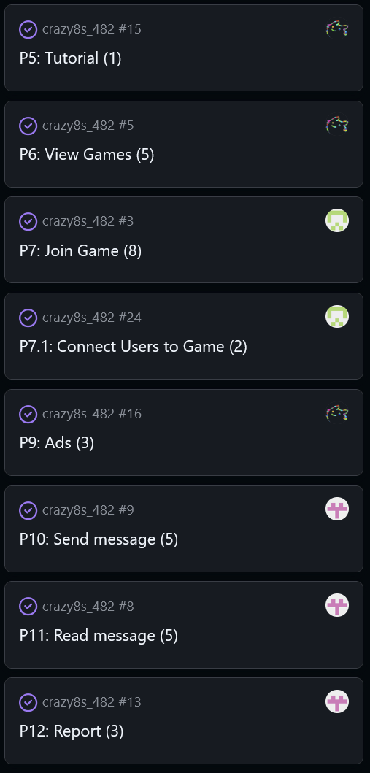
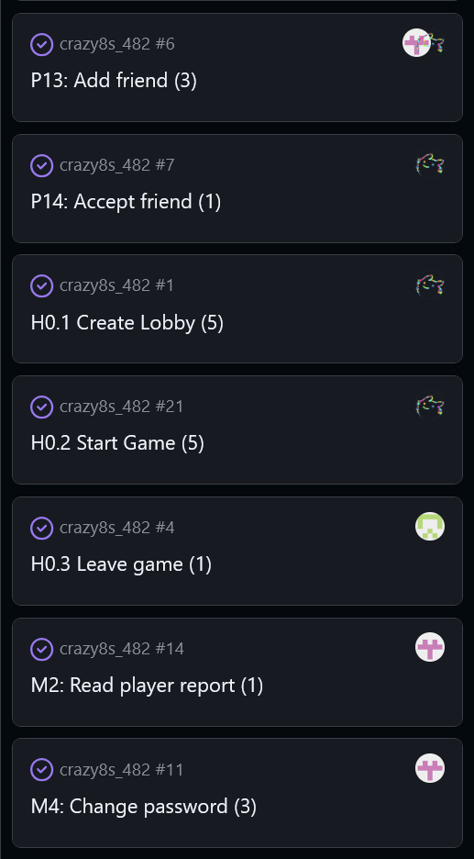
Notes:
23 user stories, taken from kanban
Stories starting with A are account related, P is player related, H is host related, and M is admin related
Pink icon is Will, Green is Jack, Multicolor is Victoria
Stories labeled H0.3 or P7.1 are slices determined during later sprints

Slide 8
Development

Slide 9
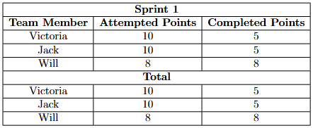
Sprint 1
Will
CRUD For Accounts
Jack
Play Card
Draw Card
Victoria
Start Game
Create Lobby
Notes:
Bigger table, organization

Slide 10
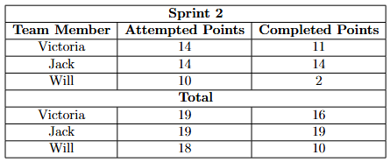
Sprint 2
Will
Account Login / Sign up
Change password
Jack
Join Game
Leave Game
Play Card
Victoria
Create Lobby
Accept Friend
View Games

Slide 11
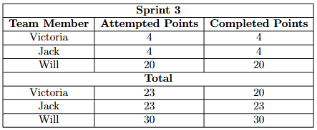
Sprint 3
Will
Add Friend
Send/Read Messages
Reports
Change password
Jack
End Game
Connect users to game
Victoria
Tutorial / Ads
Technical Task: Improve UI

Slide 12
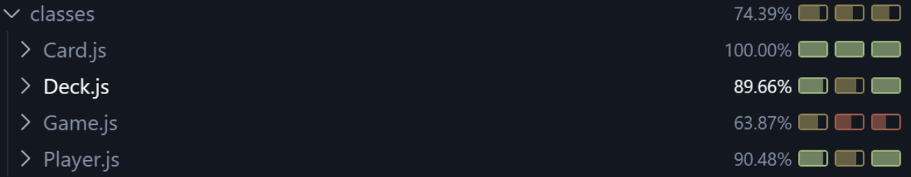
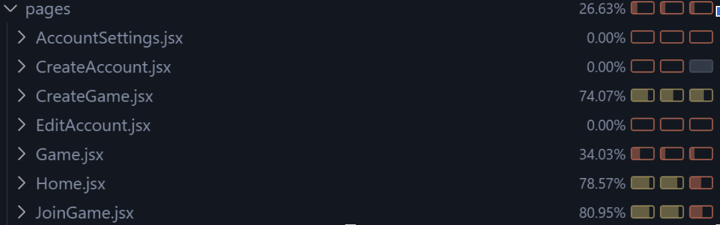
Testing
Written with Jest
Backend game functionality was well covered
Webpage functions and components lacked in coverage
Neglected testing, something to consider for next time

Slide 13
Reflection
No specific leader, we did not need one
Learned to communicate and work effectively as a team
Main barrier was lack of knowledge and time, which affected quality

Slide 14
Demo

